Slide 1
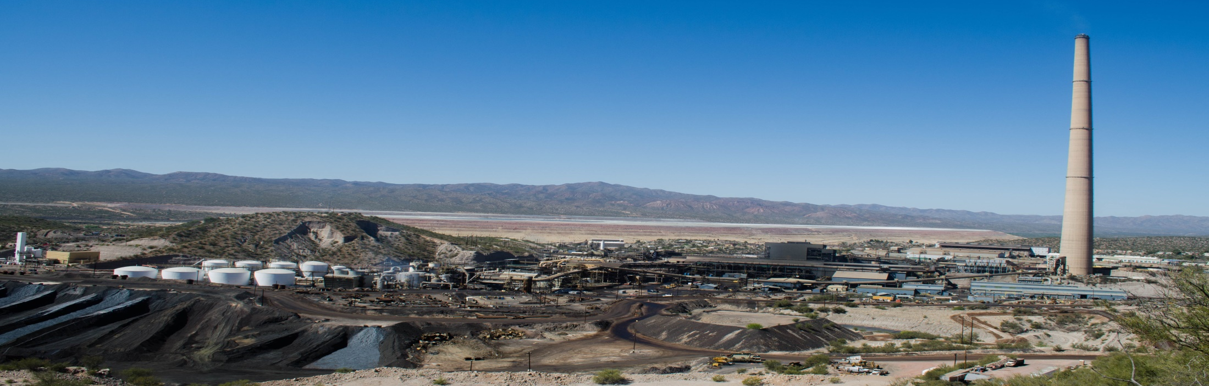


Airborne Lead in Hayden, AZ
REMAN Almusawi
Arizona Space Grant – 2019 Symposium
Acknowledgements: Dr. A.E. Sáez, Dr. E.A. Betterton, MS. T. Rodriguez-Chavez, K. P. Rine, R. F. O’Brien-Metzger
Notes:
intro slide, point out picture as study side

Slide 2
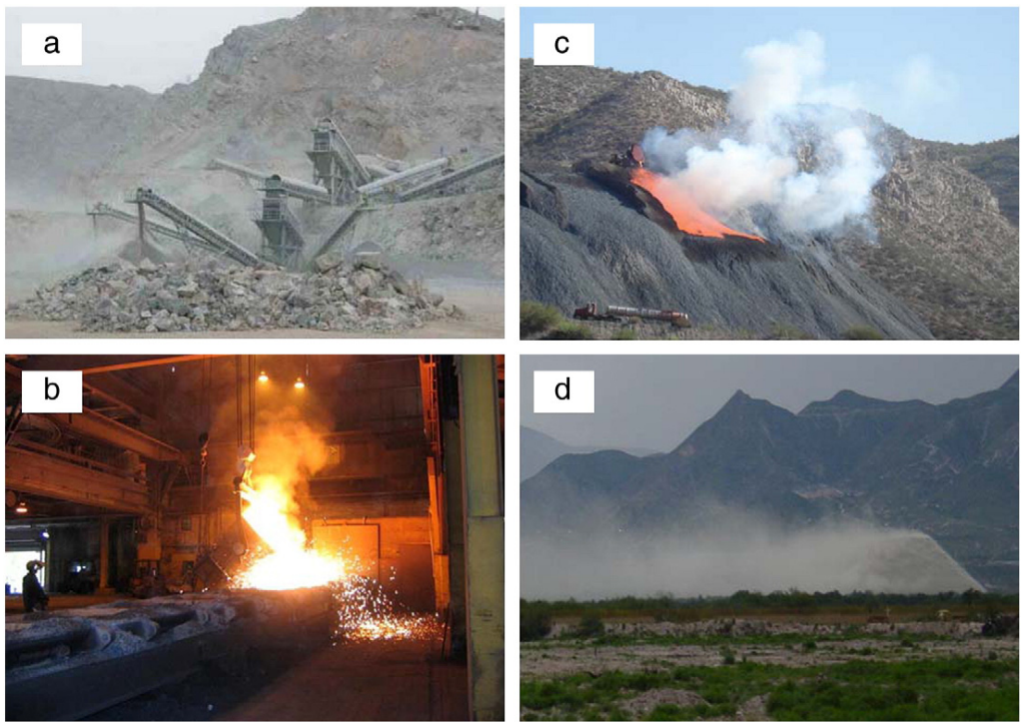
Introduction
A. CRUSHING & GRINDING
C. SLAG DUMPS
2008
ASARCO installed controls on refining operation - overall lead emissions reduced by 50%
Mandatory cleanups
2014
Nonattainment designation by EPA
2015
$150 million settlement between US EPA and ASARCO LLC
ASARCO mandated to implement new technologies
B. SMELTING
D. WIND EROSION OF MINE TAILINGS
Source: Modified from (Csavina et al., 2012)
Notes:
quickly go over mining operations, timeline, discuss $150 million settlement with EPA & ASARCO
a non-attainment area means air quality is worse than national air standards.

Slide 3
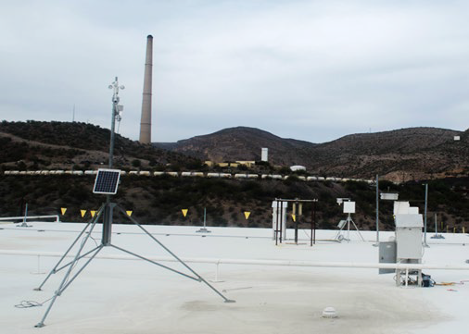
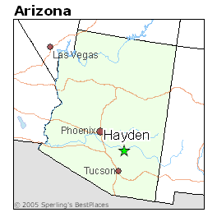
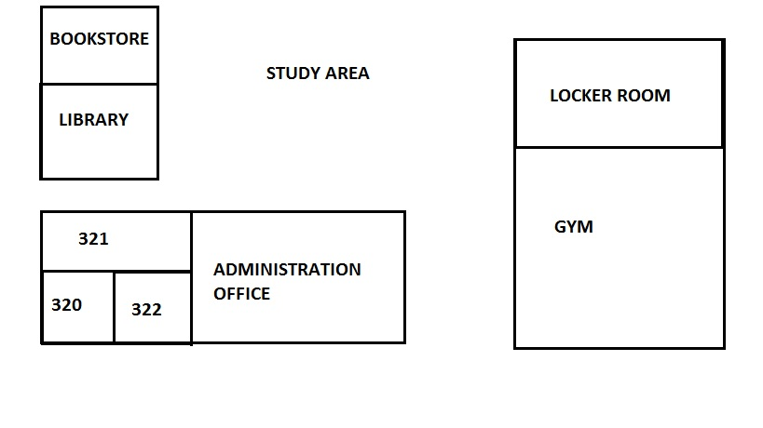
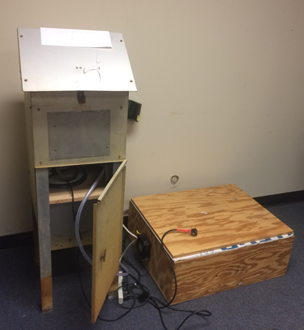
Study Site Hayden High School
Outdoor MOUDI
Indoor MOUDI
Outdoor MOUDI
Indoor MOUDI
Notes:
introduce study site as well as method (indoor vs outdoor) Point out proximity of smoke stack & slag pile to high school.. Discuss health effects of lead

Slide 4
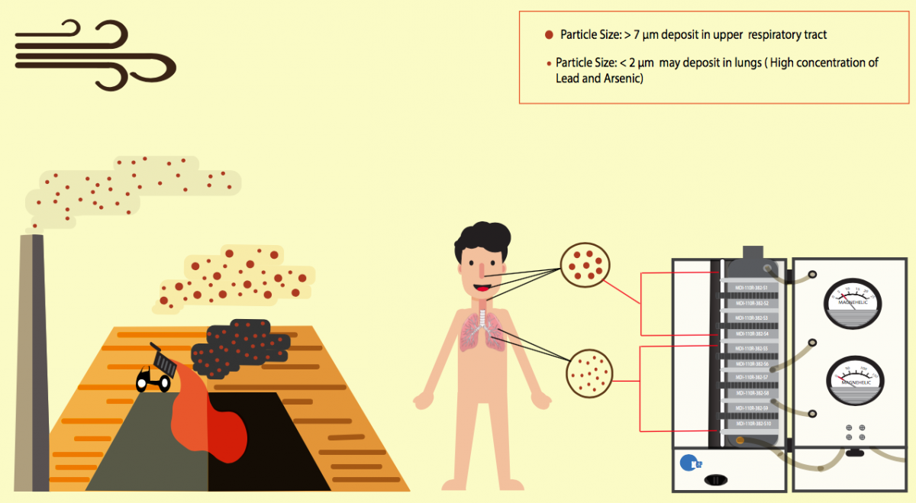
Why is it important?
Source: superfund.arizona.edu/personnel/trainees/tania-b-rodriguez
Notes:
On this slide describe why size matters --
Small particles have to go thru lungs, big particles you just swallow or cough back out.. describe the moudi for size distribution study.. mention health effects of lead again

Slide 5
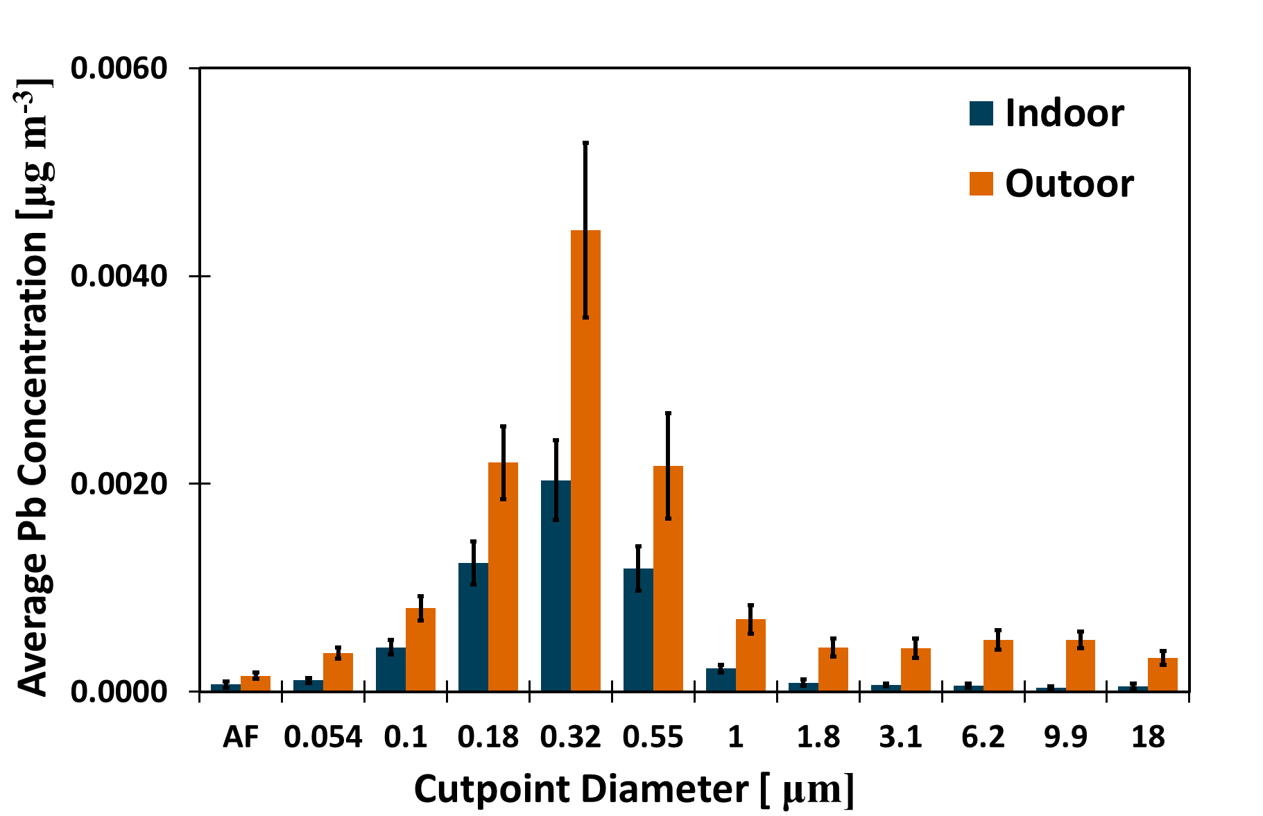
Results: Lead in Atmospheric Dust
Source from T. Rodriguez; unpublished data
Notes:
Go over results, point out diameters & show amount of outdoor lead going indoors.. state that lead is elevated but not beyond epa standards, however elevated is dangerous with chronic exposure.

Slide 6
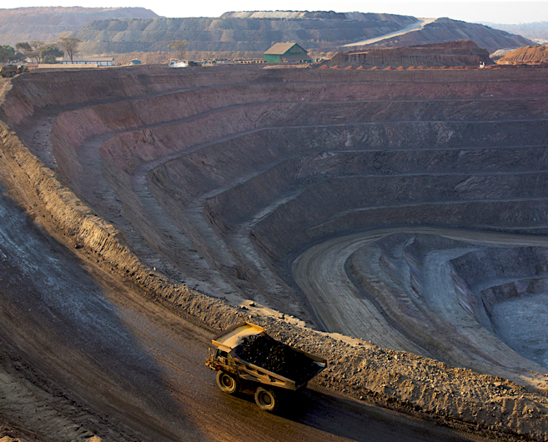
Conclusions
It is important to investigate the lead content in the different sizes of the particles.
Indoor air lead concentrations are 50% of the corresponding outdoor values.
Fine particles make it into the indoor environments with a relatively elevated concentration of lead.

Slide 7


Thank You
Dr. Avelino Eduardo Sáez
Dr. Eric Betterton
Kyle Rine
Ruby O’Brien-Metzger
MS Tania Rodriguez-Chavez
Notes:
Thanksss everybody

Slide 8
References
Csavina, J., Field, J., Taylor, M. P., Gao, S., Landazuri, A., Betterton, E. A., & Sáez, A. E. (2012). A review on the importance of metals and metalloids in atmospheric dust and aerosol from mining operations. Science of the Total Environment, 433, 58-73.

